Slide 1
Pls 2000 power & politics DR. SHANNON
World Politics I:
Sovereign States, Power and Anarchy

Slide 2
states, power & anarchy
POLITICS & INTERNATIONAL POLITICS
RISE OF THE STATE SYSTEM
REALISM & STATECRAFT
TERMS TO KNOW
Peace of Westphalia Multipolarity Bipolarity Unipolarity
Deterrence Realism Compellence Bandwagoning
Influence Hegemonic Stability Theory (HST) MAD
Balance of power Power Transition Preventive war Anarchy

Slide 3
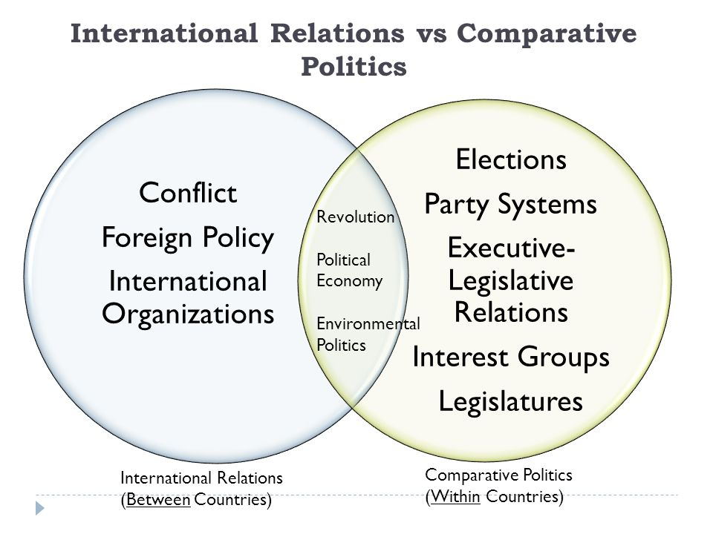
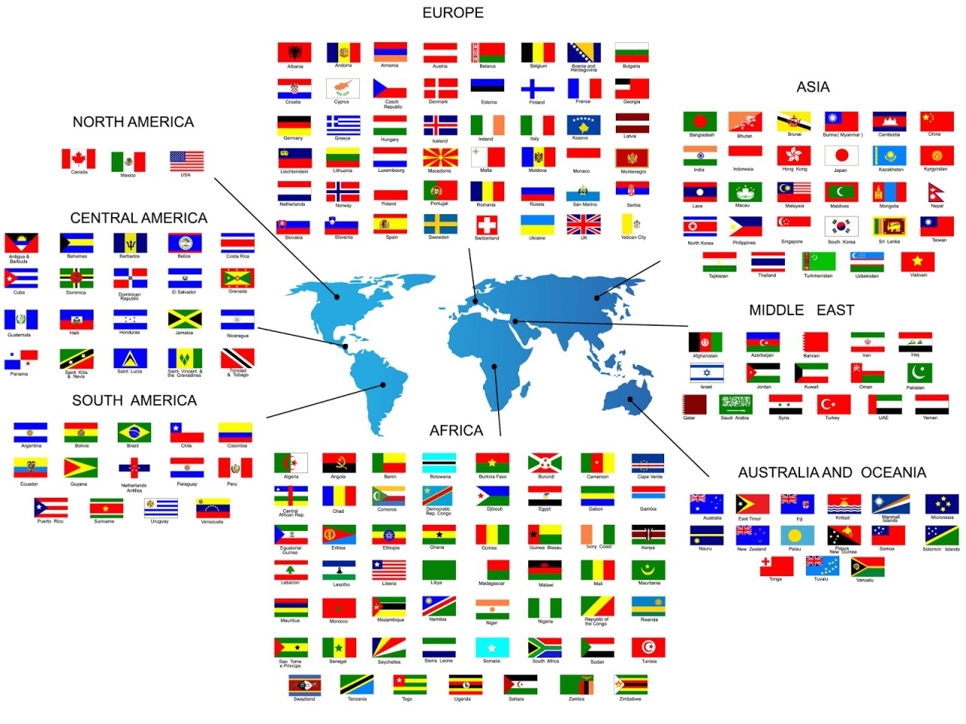
I. Politics & INTERNATIONAL POLITICS
Politics:
The art of the possible
Who gets what, when, how & why
Who rules/who governs
The authoritative allocation of values
International Politics: How sovereign states compete and exercise influence to affect the allocation of values and distribution of resources in a world lacking a higher authority to enforce laws or provide for security

Slide 4
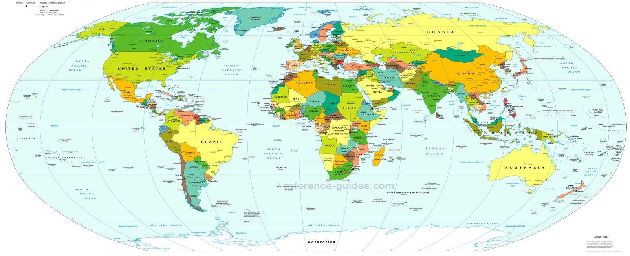
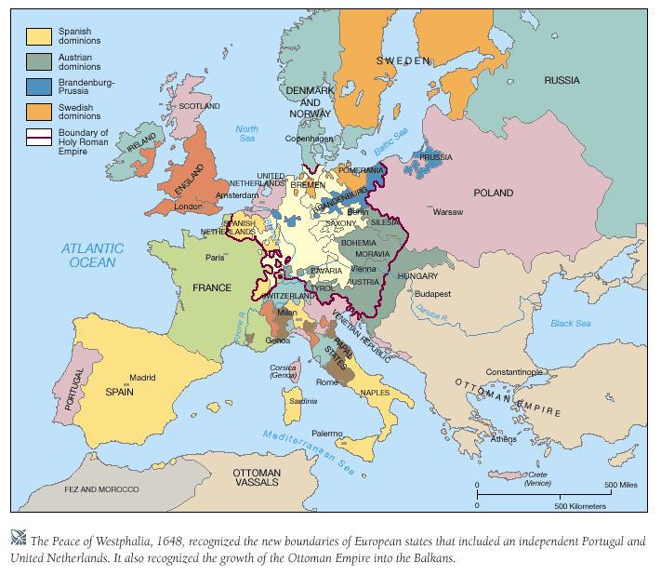
II. Rise of the state system
1648 Treaty of Westphalia
Nationalism, Self-Determination and the Rise of Sovereign States
Notes:
Treaty of Westphalia: a treaty that ended the 30 years war. Is seen as the birth of the modern soverign state system

Slide 5

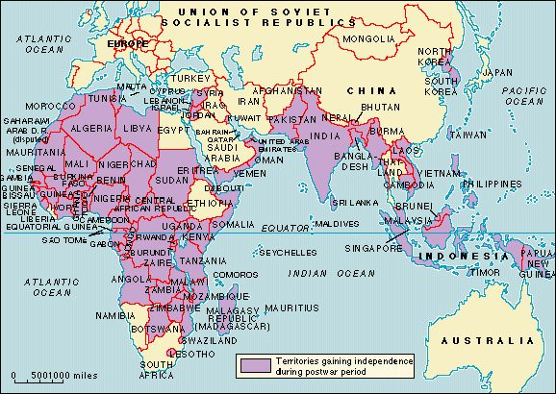
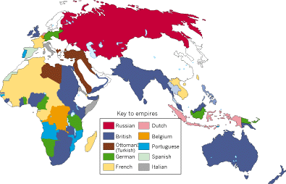
Colonialism & Decolonization
WWI & SELF-DETERMINATION

Slide 6
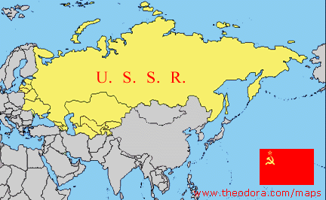
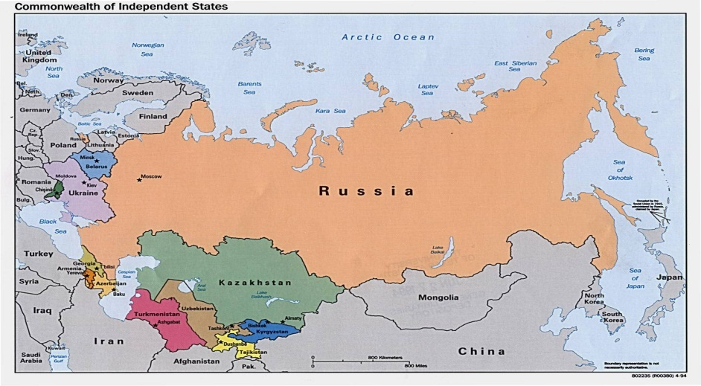
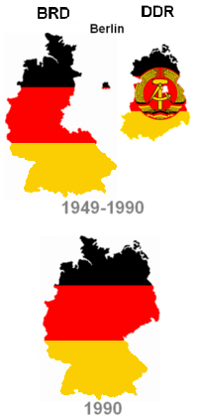
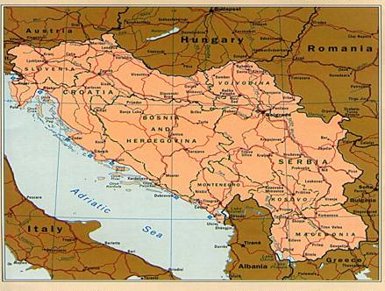
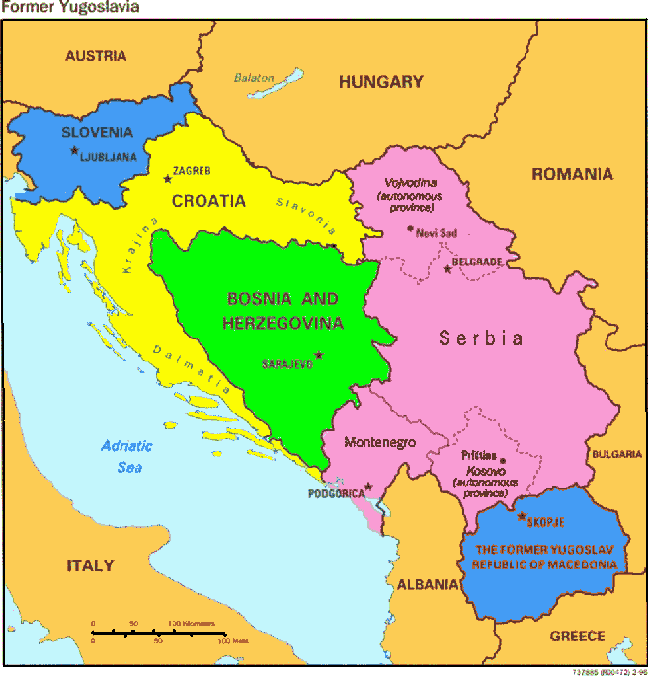
Disintegration & Integration

Slide 7
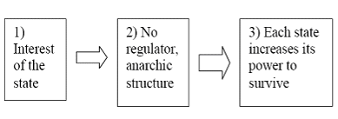
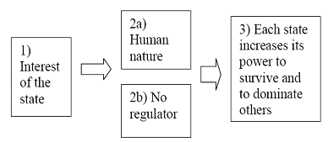
iii. Realism & statecraft
Pessimists about Selfish, aggressive, power-hungry human nature
Anarchy: Lack of a higher authority in the international system to enforce laws and protect states
Results in competition & conflict
Uncertainty of intentions
Fear & distrust
Self-help orientation
Whom to fear most? “Every person against all others”

Slide 8
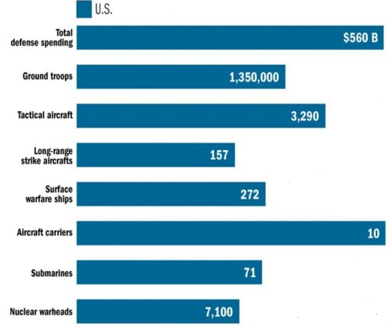
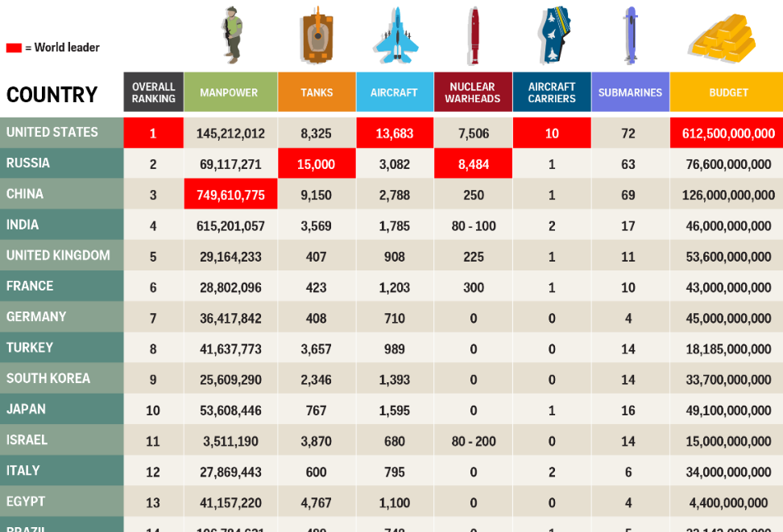
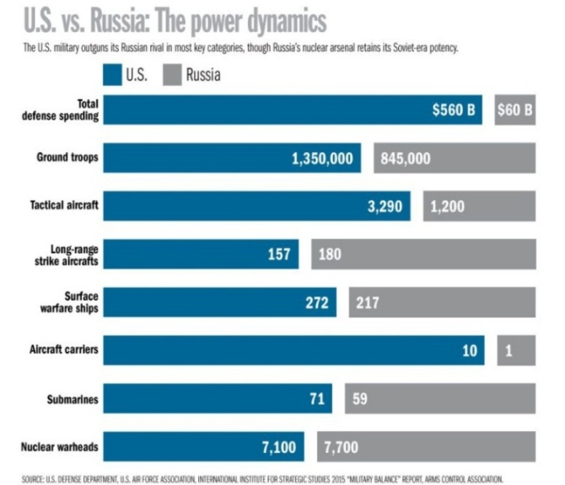
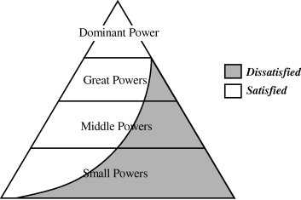
Power
“Threat Inheres in Power”
Is Material: military and economics resources to act
Is Relative: who has more or less
Defines Interests & Policy?
http://www.heritage.org/research/reports/2015/11/assessing-common-arguments-for-cutting-national-security-spending-informing-current-and-future-budget-debates

Slide 9
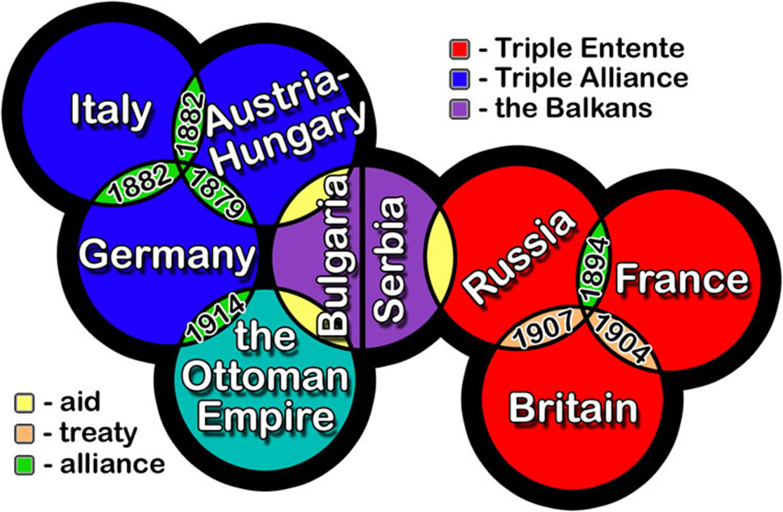
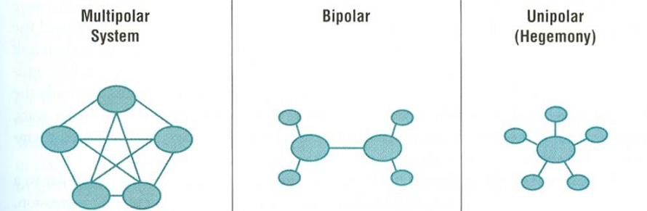



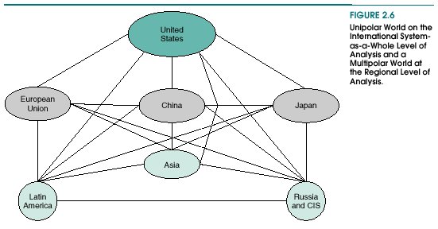
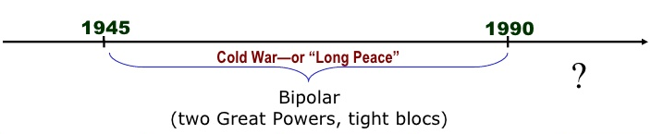
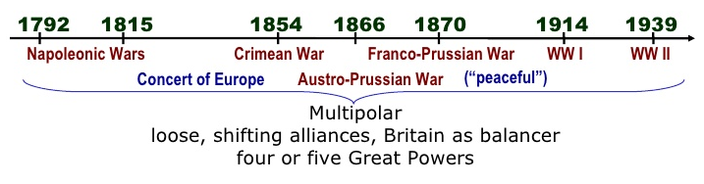
PoLarity
the international distribution of power
the # of Great Powers capable of threatening others
Multipolarity: 3+ GPs
External balancing
Flexible alliances & more major war
Bipolarity: 2 GPs
“internal” balancing
Rigid alliances & less major war
Unipolarity: 1 GP
Unbalanced system: balance or bandwagon?
http://scottwebsterministries.org/article/a-multi-polar-world

